Slide 1

Chapter 6
Nonverbal Communication

Slide 2

Definition: Nonverbal Communication
Principles of Nonverbal Communication
Types of Nonverbal Communication
Improving Nonverbal Communication
Gender Differences
Cultural Differences

Slide 3


Defining Nonverbal Communication
All aspects of communication other than words themselves

Slide 4
Similarities Between Verbal and Nonverbal Communication
Similarities
Differences
Both are symbolic.
Both are rule-guided.
Both can be intentional or unintentional.
Both are culture-bound.
Nonverbal communication is usually perceived as more believable.
Nonverbal can be multi-channeled.
Nonverbal is continuous.

Slide 5
Principles of Nonverbal Communication
Nonverbal Communication May Supplement or Replace Verbal Communication
Nonverbal Communication May Regulate Interaction
Nonverbal Communication Often Establishes Relationship-Level Meanings

Slide 6
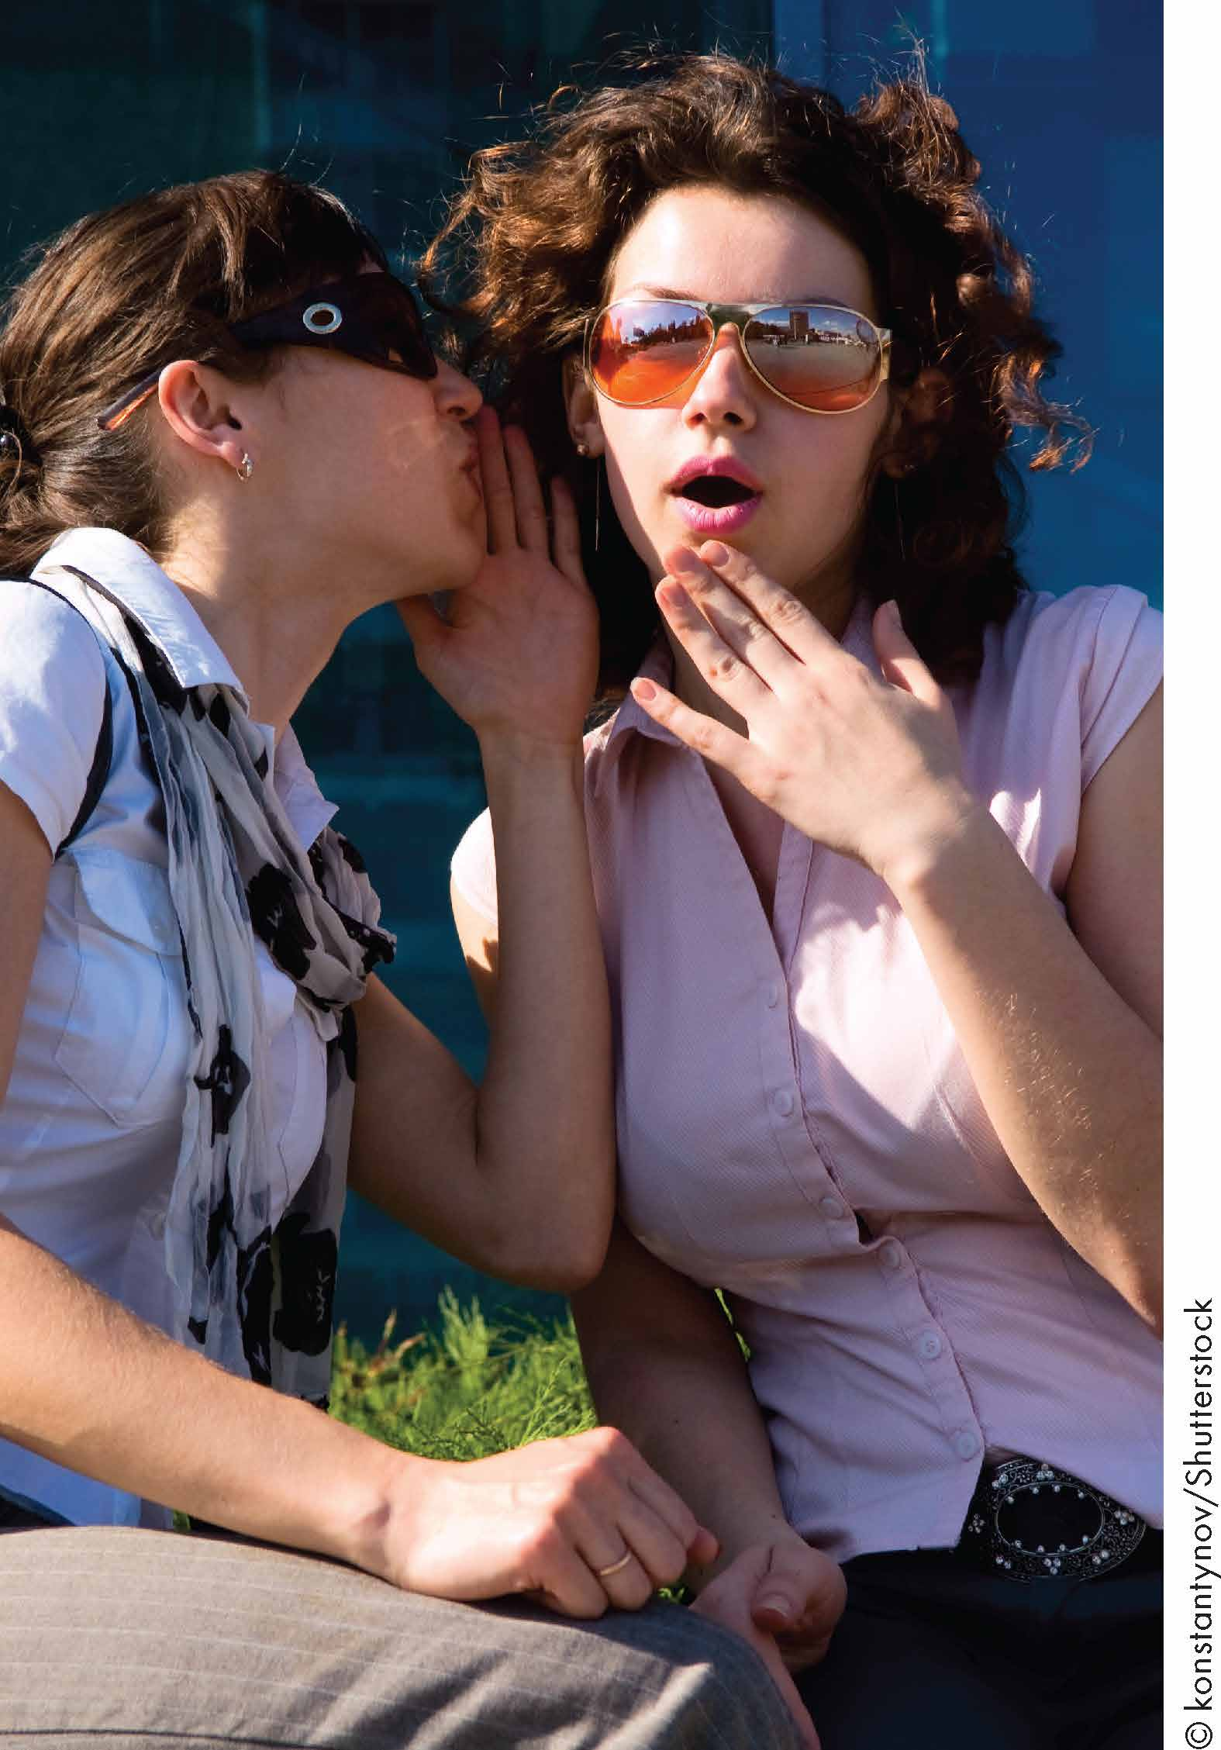
Interaction of Nonverbal and Verbal Communication
Repeating
Highlighting
Complementing
Contradicting
Substituting

Slide 7
Relationship-Level Meaning
Responsiveness
Indicate our interest in others
Immediacy
Liking
Positively or negatively we feel about others
Smiles, friendly touching
Power
Dominance
Status
Influence

Slide 8
Dimensions of Relationship-Level Meanings
Responsiveness
Liking
Power
Nonverbal Expression

Slide 9
Types of Nonverbal Communication
Kinesics
Movement
Haptics
Touch
Physical Appearance
How We Look
Artifacts
Personal Objects
Environmental factors
Settings Like Architecture, Colours
Proxemics
Space
Chronemics
Time
Paralanguage
Vocalization
Silence

Slide 10
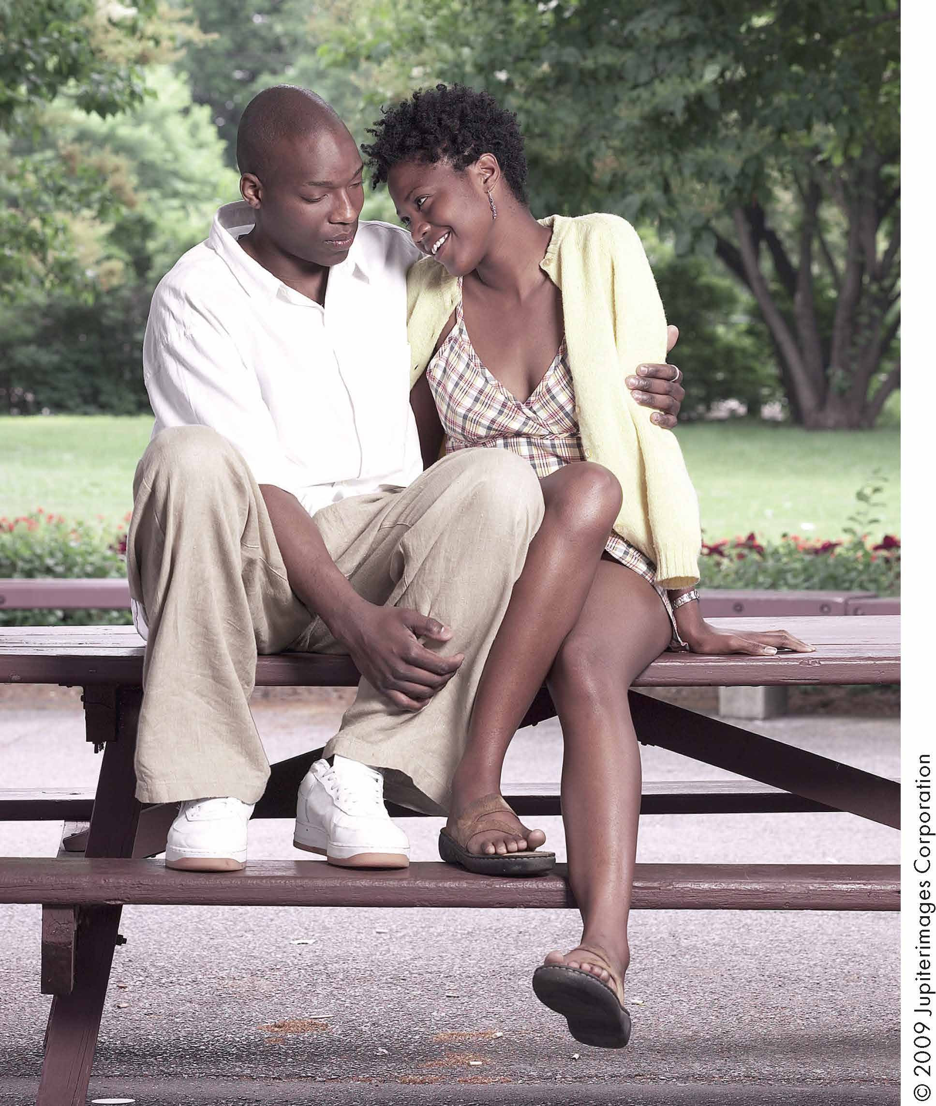
Guidelines for Improving Nonverbal Communication
Monitor Your Nonverbal Communication
Be Tentative When Interpreting Others’ Nonverbal Communication
Perspective taking – first versus third.

Slide 11
Gender and Nonverbal Display
Women engage in more eye contact and initiate touch more than men.
Women smile and return smiles more than men.
Women use nonverbal displays more but are also better at deciphering nonverbal behaviour.

Slide 12
Culture and Nonverbal Display
Contact cultures
- Depend on touch
- Latin America, Mediterranean, Eastern Europe
Noncontact cultures
- Depend less on touch
- Scandinavia, North America
- Religious groups

Slide 13
Summary
Definition
Studies of Nonverbal Com.
Principles
Chapter 6
Culture
Types
Gender
Guidelines

